Slide 1
Augmented Reality with Homographies
Alex Szilagyi – A20324479
Avichel Verma – A20424121

Slide 2
What is Augmented Reality?
It is a field of computer science that gives an interactive experience of real-world environment where object that reside in the real-world are digitally processed and augmented by adding various computer-generated graphics.
How AR Works?
The primary idea of augmented reality is to superimpose graphics, audio and other components of the digital world into a person’s perception of real-world environment in real-time.

Slide 3
Problem Statement
Problem: Augmented Reality often requires a large amount of computational power and is relatively unfit for real-time application.
Solution: Through applying techniques of ORB feature detection, Homography, and projective transformations, we are able to provide an application that showcases some use cases of AR on a computationally limited systems.

Slide 4
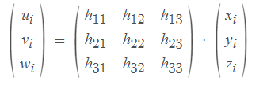
Augmented reality Camera Tracking with Homographies
Paper : https://ieeexplore.ieee.org/document/1046627?arnumber=1046627
Proposal :
To integrate 3D models into an unprepared environment, camera position is estimated by tracking image feature point.
A robust tracking system based on computing homographies is implemented in order to map ORB descriptor feature points to the reference model.
Corner points are identified in two images.
Initial matches based on the similarity of area around these corners are likely matched. Initial set contains many incorrect matches.
We calculate the associated homography.
Finally, we count the number of matches that are in agreement with inliners and repeat this process after recalculating the homography using all of the inliners.

Slide 5
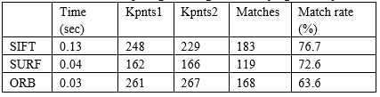
Image Matching Using SIFT, SURF, BRIEF and ORB: Performance Comparison
Paper : https://arxiv.org/ftp/arxiv/papers/1710/1710.02726.pdf
Proposal :
Compare the performance of three image matching techniques i.e., SIFT, SURF and ORB against different kinds of transformations such as scaling, rotation and noise.
For this, we perform different types of transformation on original images and compute matching evaluation parameters such as number of key points, matching rate, execution time required for each algorithm and displays the result to show which algorithm in robust against the others.

Slide 6
Implementation
Utilize Python and Open CV for:
ORB - Feature Detection
BFMatcher – Brute Force Feature Matching
Homography – One to One image mapping (Reference Image to World Image)
Projection – Performed Transformations to centralize and rotate the 3D object while rendered
RANSAC – Eliminate outliers (noise) in image detection

Slide 7
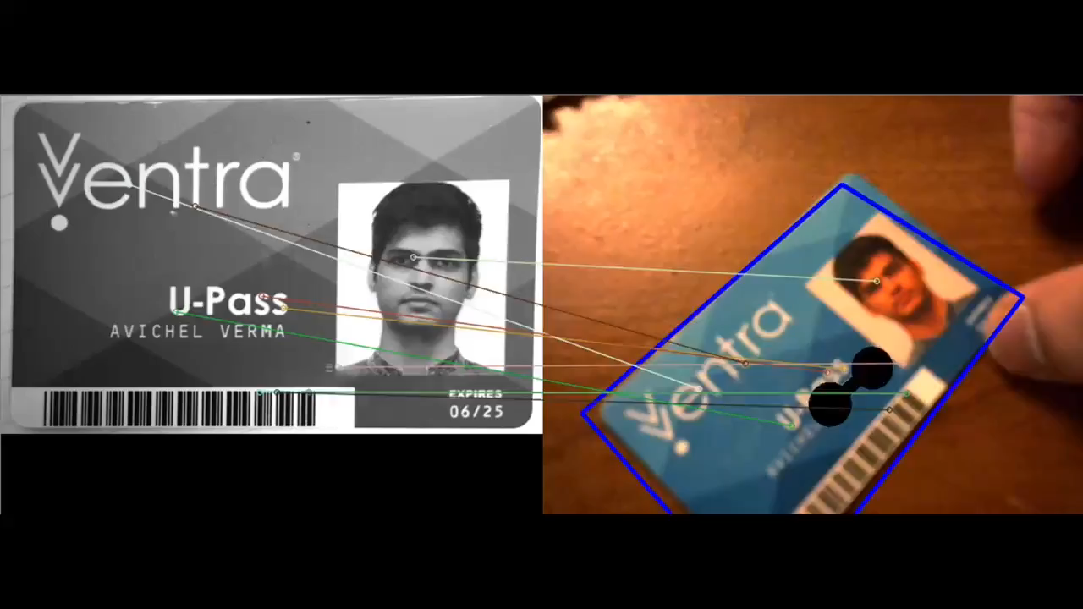
DEMO

Slide 8
Questions?

